Slide 1


Introduction to Research Data Management
Joy Davidson
Digital Curation Centre

Slide 2
About this course
Short presentations with exercises and discussion
Research Data Management Landscape
Research Data Management at the University of Glasgow
Introduction to Data Management Planning
Data description exercise
DMPonline demonstration

Slide 3
Data Management Planning
Research Data Management Landscape
Data Management Planning

Slide 4

“Data sets are becoming the new instruments of science”
Dan Atkins, University of Michigan

Slide 5

Digital data as the new special collections?
Sayeed Choudhury, Johns Hopkins

Slide 6
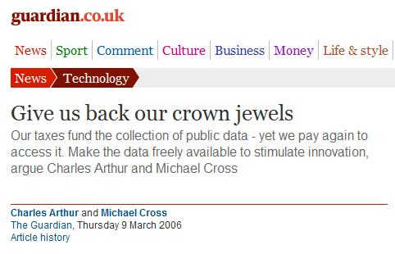

Research data: institutional crown jewels?
http://www.flickr.com/photos/lifes__too_short__to__drink__cheap__wine/4754234186/

Slide 7
Exceptions to copyright
*Reforms to copyright law come into force on 1st June*
The exceptions coming into force today will bring a range of benefits to a wide range of groups:
Researchers will benefit from the introduction of the new text and data mining exception for non-commercial research, as well as the reforms to existing
Libraries, archives and museums will now be better able to protect our cultural heritage and preserve their collections. The existing preservation exception has been expanded to cover all types of copyright work, and now applies to museums and galleries as well as libraries and archives.

Slide 8

Funders’ expectations of public access
“Publicly funded research data are a public good, produced in the public interest, which should be made openly available with as few restrictions as possible in a timely and responsible manner that does not harm intellectual property.”
RCUK Common Principles on Data Policy
http://www.rcuk.ac.uk/research/Pages/DataPolicy.aspx

Slide 9
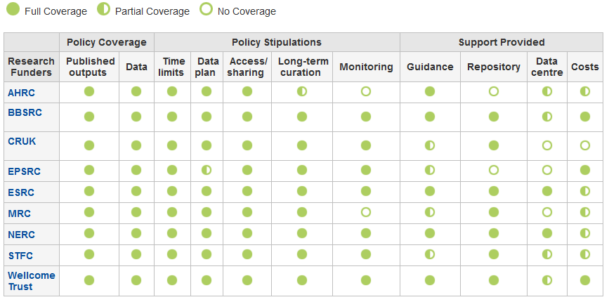
Research funder data policies
www.dcc.ac.uk/resources/policy-and-legal/ overview-funders-data-policies

Slide 10

Ultimately funders expect:
timely release of data
  once patents are filed or on (acceptance for) publication
open data sharing
  minimal or no restrictions if possible
preservation of data
  typically 5-10+ years if of long-term value
See the RCUK Common Principles on Data Policy:
www.rcuk.ac.uk/research/Pages/DataPolicy.aspx

Slide 11

“Research organisations will ensure that effective data curation is provided throughout the full data lifecycle, with ‘data curation’ and ‘data lifecycle’ being as defined by the Digital Curation Centre. The full range of responsibilities associated with data curation over the data lifecycle will be clearly allocated...”
...institutional responsibility
www.epsrc.ac.uk/about/standards/researchdata/Pages/expectations.aspx

Slide 12
Data Management Planning
Research Data Management Costs
Data Management Planning

Slide 13
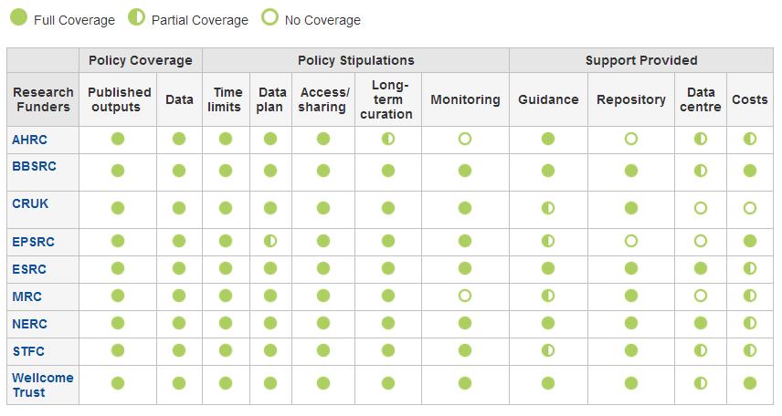
Research funders’ policies
www.dcc.ac.uk/resources/policy-and-legal/overview-funders-data-policies

Slide 14
Key differences in policies
Preservation periods range from 3 years to in perpetuity
  most funders ask for 10+ years
ESRC and NERC may withhold the final grant payment if data aren’t offered for deposit
Cancer Research UK states explicitly that it will NOT provide additional funds for RDM

Slide 15
What RDM cost can be included?
Need to distinguish between the costs that are incurred during a project and those that arise afterwards.
In-project (direct) costs:
  covers hardware, staff, expenses, costs of preparing data & metadata...
Post project (largely indirect) costs:
  existing services should be used where possible
  where an institution is going to provide a data repository, costs should be met through FEC
  outsourcing to a third-party is also an option
Owing to its charity status, the Wellcome Trust in general only pays directly incurred costs.

Slide 16
How should costs be included?
In-project costs should be included in the direct costs for a project
Post-project costs could be direct (e.g. charges levied by data centres) but typically fall into indirects as universities should provide infrastructure to support RDM
The Justifications of Resources should, where possible, separate out the following RDM cost elements:
  cost of collecting data
  the cost of curating data
  the cost of analysing data
  the cost of preservation and sharing

Slide 17
Key messages
Research data management should not be regarded as optional.
DMPs should make clear what is provided and what activities are being charged against a grant
The cost of RDM is project-specific and entirely depends on the type of work.
It may be possible to set up small research facilities to recover the cost of RDM (e.g. similar to provision of HPC), possibly as a cross-institutional service.

